Slide 1
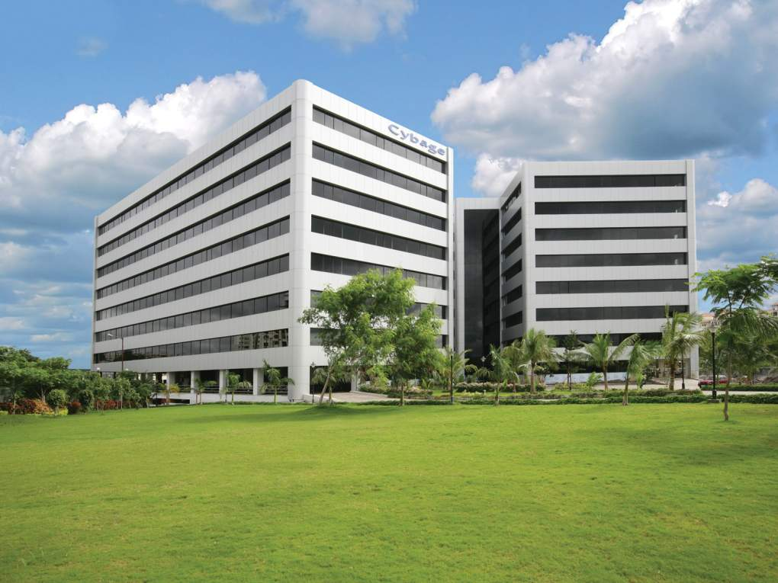

TFS Overview
This document and all its contents contain information from Cybage Software Private Limited which may be privileged, confidential, or otherwise protected from disclosure. The information is intended to be for the addressee(s) only. Any unauthorized disclosure, copy, distribution, or use of the contents of this message is strictly prohibited.

Slide 2
Agenda
Challenges in Project Execution
ALM and TFS
Work Item Tracking
Version Control System
Code Quality

Slide 3

Challenges in Project Execution
Misunderstood Requirements
PRODUCT
BACKLOG
Can’t Get Actionable Feedback
Can’t Reproduce Production Incident
Conflicting Priorities
Quality Suffers
Can’t Identify Root Cause
Sprint
Monitor
No Traceability
Lost Focus
Late Delivery
OPS
BACKLOG
Unmet User Exceptions
WORKING SOFTWARE
Notes:
- BA’s, Devs, Testing teams were working in Silo.

Slide 4
ALM – Application life cycle management
ALM is managing life of an application through governance, development and maintenance.
Objectives
Productivity
Quality
How ?
Process
Tool
Skill

Slide 5
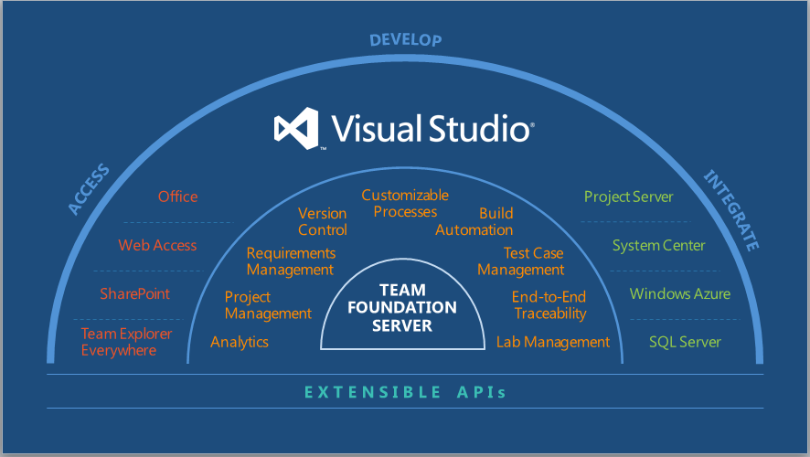
TFS : ALM

Slide 6
Features overview
Version Control
Architecture
Report
Lab Management
Testing
Work Item tracking
Development
Build Automation

Slide 7
TFS : Work item tracking
Work Item : Tracking
Requirement, User story, Product backlog Item, Task, Bug, Test case,
Change request, Review Request, Review response, Feedback, Issue …
Traceability : Link/Association
Parent/child, Tests/Tested by, Implements/Implemented by, Fails/Failed
by, Predecessor /Successor, Hyperlink, Affects/Affected by …

Slide 8
TFS : Version control
Version Control
Common features
Check in,
Checkout
Merging
Shelving
Change set
History
Label
File compare

Slide 9
TFS : Code quality
What is code quality ?
How to ensure code quality ?
Code review
Automation
Static code analysis
Code metrics
Tracking the code review ?
Code review workflow

Slide 10
Thank you

